Slide 1
Student Management System + Updates
Emmanuel Mendoza

Slide 2
What is the product?
The idea is to a create a student management system with a feature not seen before: Quick Chat.
Most SMS (student management systems) are very similar
Wanted to bring something “new” to the table

Slide 3
Who is it used for?
Used primarily for students and teachers
However, admins have a role as well
Allows students and teachers to see grades, assignments, etc. for their courses
Allows admin roles to create transcripts

Slide 4
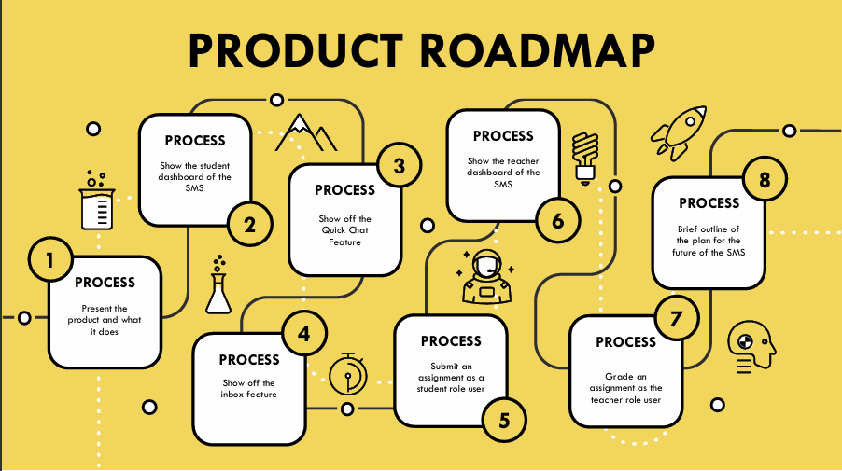
Original Product Roadmap

Slide 5
New Product Roadmap
Show Admin Dashboard
Create a report
Show off the student transcript
Send report to requestee

Slide 6
NOW ONTO THE UPDATED DEMONSTRATION

Slide 7
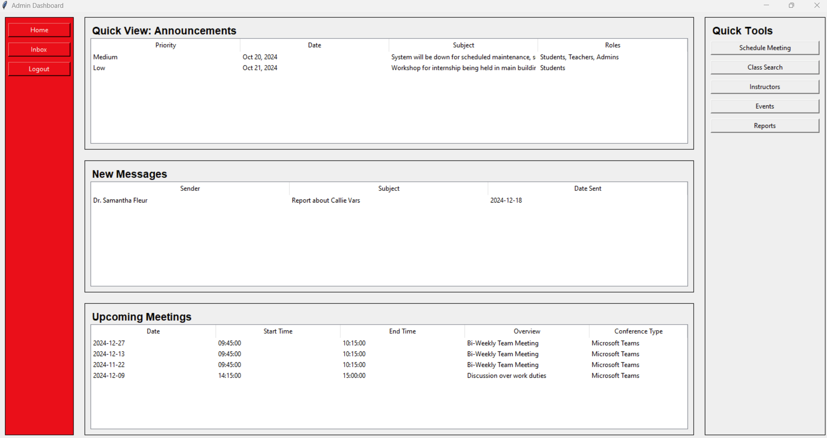
After logging into the admin dashboard, we are greeted to the home screen which showcases different tools for the admin user. Their meetings, inbox, and work assignments are dynamic according to what is assigned and sent to the admin user.

Slide 8
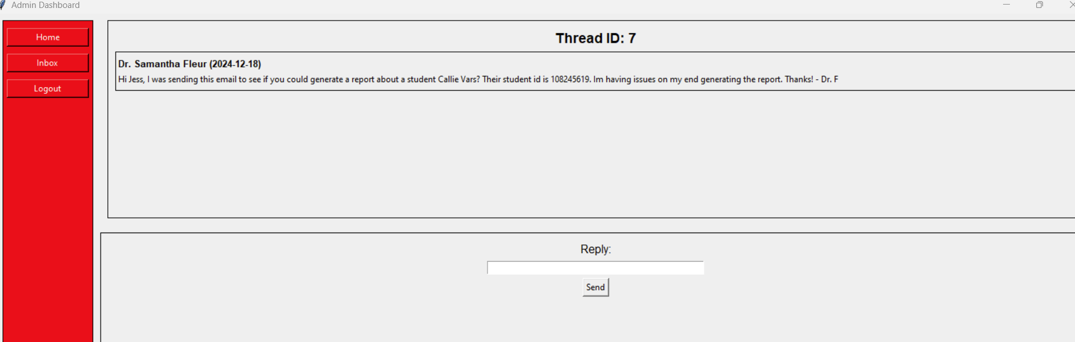
When we check the admin’s messages, we see one of the professors asking for the admin to generate a report of a student for them.

Slide 9
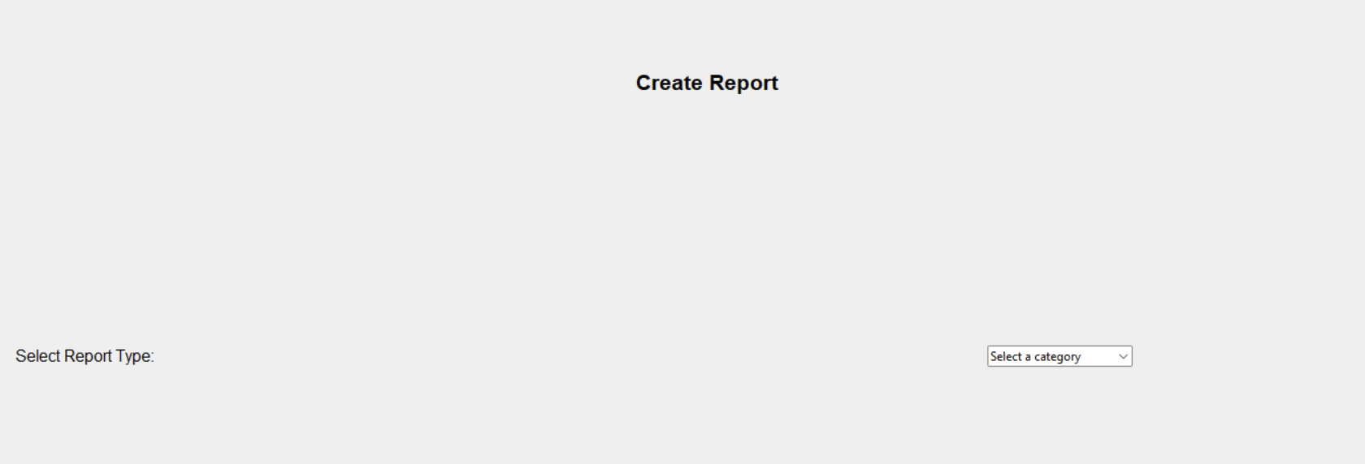
So we go to ‘Report’ button and click it under Quick Tools. It brings the user to the Create Report screen. The admin user can choose to select a category report type such as Student, Teacher, or Admin.

Slide 10
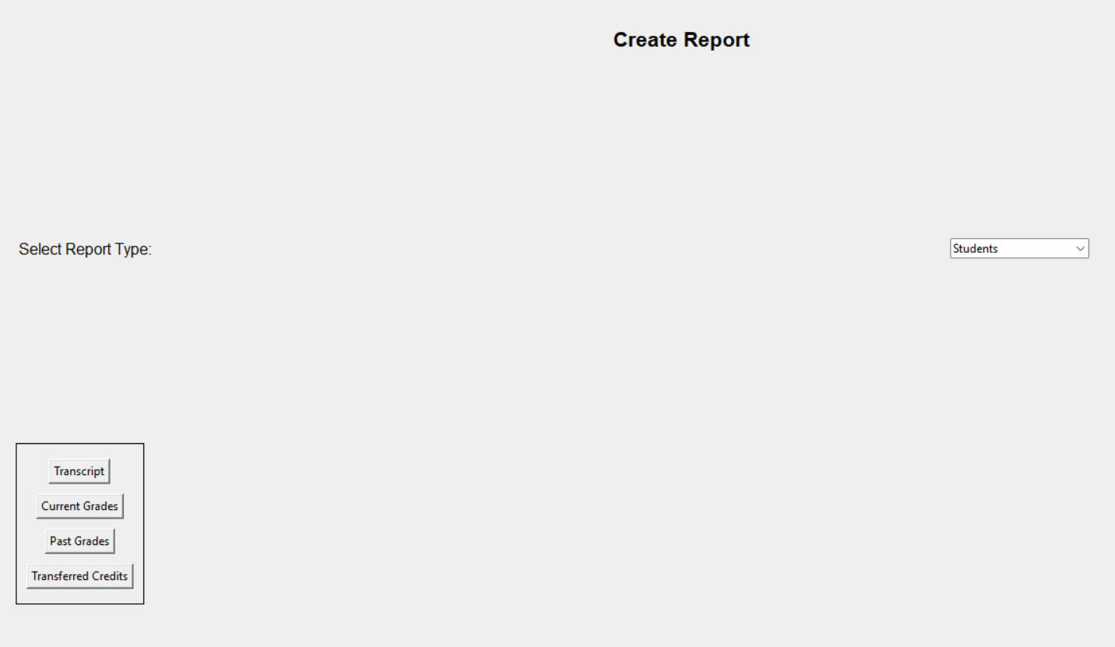
When the user chooses the Students report type, 4 different options show up - Transcript, Current Grades, Past Grades, and Transferred Credits. For our purposes, we choose transcript.

Slide 11
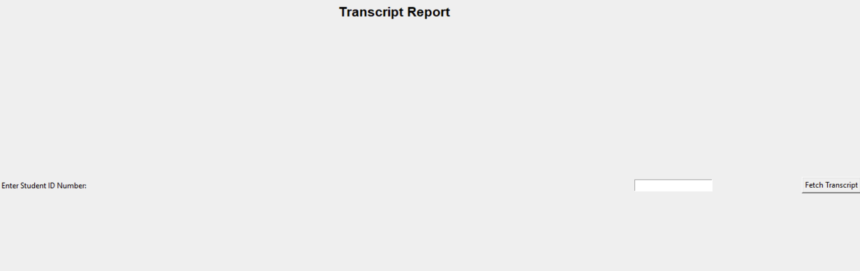
Onto the Transcript Report screen, the admin user must now put in the Student ID number.

Slide 12
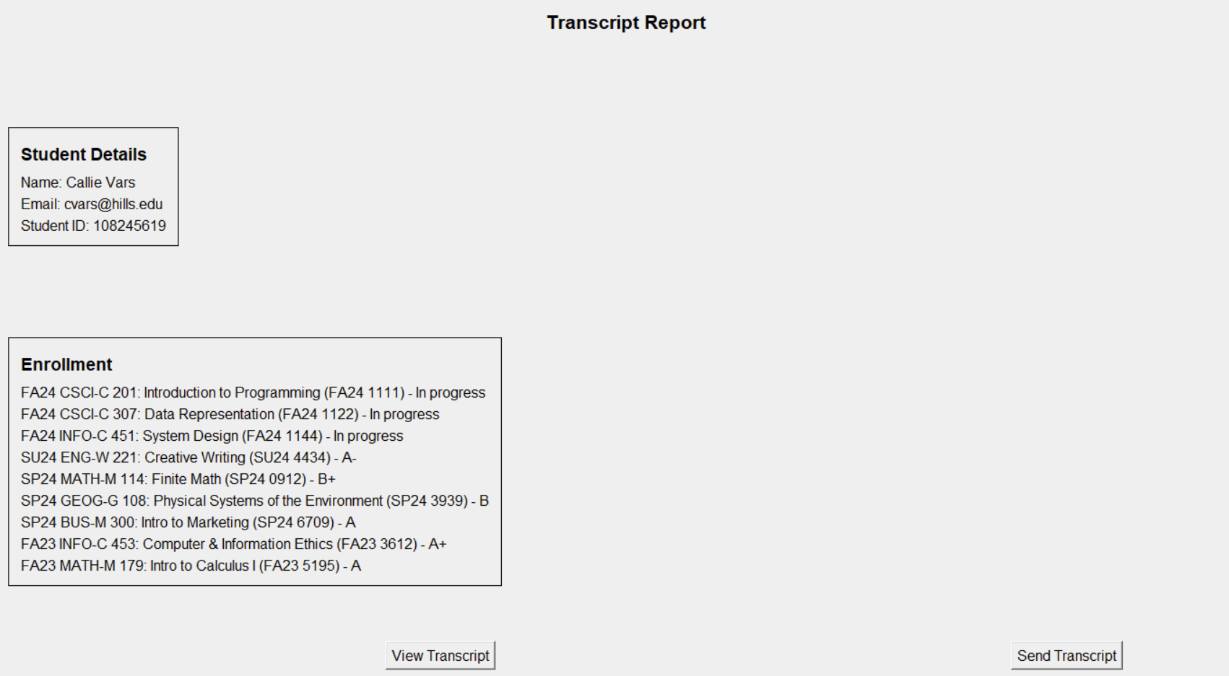
Once we put in Callie’s Student ID number, we are able to pull up her transcript including current and past courses, when they were taken, and her grades.

Slide 13
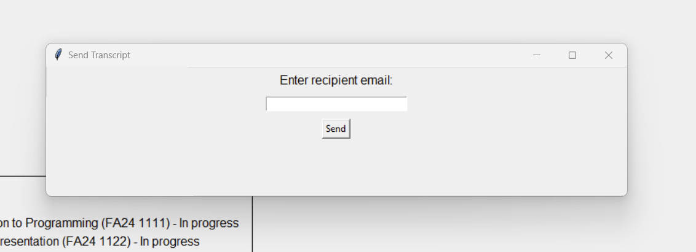
Next we want to send the transcript to Dr. Fleur’s email, so we click the Send Transcript button.

Slide 14
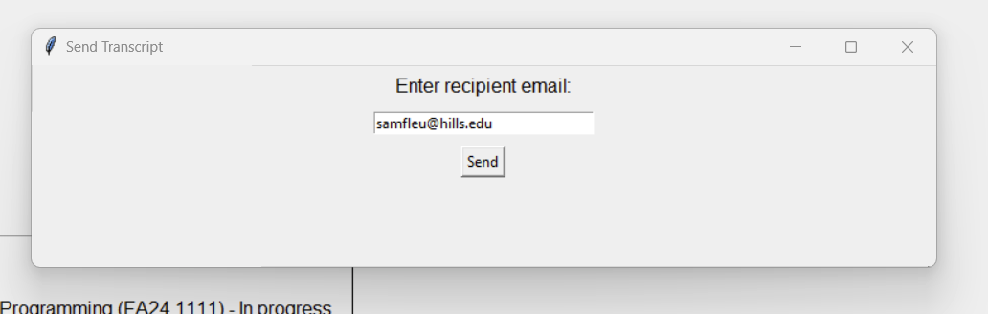
We put in Dr. Fleur’s email address to send off the transcript.

Slide 15
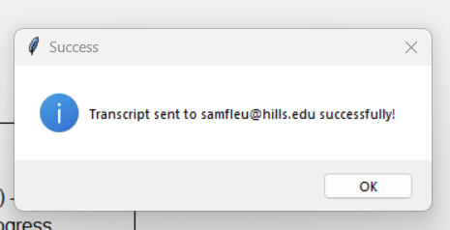
After hitting send, we get a successful message that it was sent.

Slide 16
Brief Plan for the Future
01
More course offerings
View course homepages that includes overview of the courses, syllabus, and more!
02
More course offerings Pt. 2
Create side course views - tabs such as Grades, Assignments, etc.

